Slide 1



Introduction Azure Table Storage
John Miner Data Architect
john.miner@bluemetal.com
Blog: www.craftydba.com www.mssqltips.com
Tweet: JohnMiner3

Slide 2
Target Audience
Developers
Solid understanding of what a key-value store gives you. How to create, read, update and delete entities (records).
Azure Administrators
How to use PowerShell to create and manage various Azure objects.

Slide 3
How NoSQL came about
Some technical problems lend themselves to storing and retrieving data from a relational database management system (RDBMS). Edgar Codd came up with the idea of a relational model when he was working at IBM’s San Jose Research Library in 1970. The purpose of this model was to abstract the relational database so that it was not bound to any particular application.
Other technical problems do not lend themselves to storing and retrieving data from a predefined table. The popularity of NoSQL databases started with companies such as Facebook, Google and Amazon when working with big data problems and/or real time web applications. This set of technology is coined “Not Only SQL” since they might support a SQL syntax for retrieving data.

Slide 4
Various NoSQL Offerings
A key value store uses the concept of an associative array to save and retrieve data. The Webster dictionary is the physical implementation of this concept.
A document store encapsulates all the data for an entity (document) using a popular encoding format such as XML or JSON. This technology is popular with applications that have a variety documents with different attributes.
A graph store contains a bunch of elements with a finite number of connections between them. Data such as social relationships, road maps and/or network topologies can be easily represented with this technology.
A column store saves the data using columns instead of rows. This means that columns with discrete values can be highly compressed.

Slide 5
Presentation Overview
S&P 500 data.
Review Azure storage concepts.
Create an Azure table store
PowerShell module for CRUD.
Load test table store.
Should you be “nagling”?
Azure Storage Explorer.
Mixing your entities.
Pros vs Cons of a key-value store.

Slide 6
Big Data = Stock Data?
When dealing with big data, most computer scientist talk about Volume, Velocity and Variety.
If we are talking about real time trading, the volume tickets to buy or sell at NASDAQ can be high.
The velocity is at the second or less time frame. This means many records over the period of 7 hours.
However, the variety is static. All trading data conforms to a particular format.

Slide 7
S&P 500 Stock Data
The S&P 500 stock data from yahoo financials is a subset of a big data problem.
We have roughly 500 companies defined on Wikipedia as being part of the prestigious group.
Each day, we have one record that states the open, low, high and close stock values. Also, the total traded volume is recorded.
Example 1 – Show stock data

Slide 8
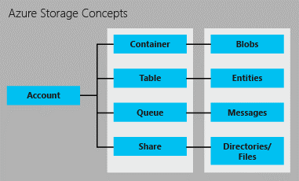
Azure Storage Concepts
Azure supplies the developer with many different storage concepts. Today, we are going to focus on table storage.

Slide 9
Access to Storage
There are three ways to access an Azure storage.
Storage Account Keys are an all access pass to the resources. There are two keys per account so that rotation can occur.
Share Access Signature is a finer way to give out access. For instance, read access for the next 30 days can be give out this way.
Sign into Azure with user name & password.

Slide 10
Three amigos
PowerShell is the defacto language to use with Azure. Microsoft did not supply cmdlets for manipulating the contents of key value store, Azure Table Store.
The following three commands are support at the topmost level.
New-AzureStorageTable
Get-AzureStorageTable
Remove-AzureStorageTable
Same actions can be performed from the Azure Portal.
Example 2 – Create test & investment store

Slide 11
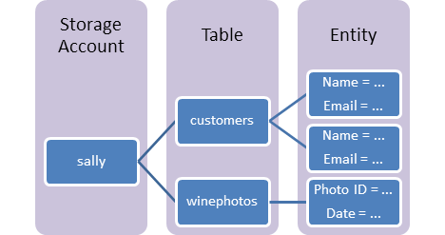
Table Storage Concepts
A table is a collection of entities. Tables don't enforce a schema on entities, which means a single table can contain entities that have different sets of properties.
An entity is a set of properties, similar to a database row. An entity in Azure Storage can be up to 1MB in size.
A property is a name-value pair. Each entity can include up to 252 properties to store data. Each entity also has three system properties that specify a partition key, a row key, and a timestamp.

Slide 12
Open Source Community
Paulo Marques who works at Microsoft create a PowerShell module to work with entities. Just search for his repository.
# Make sure we have the module
Install-Module AzureRmStorageTable
# List cmdlets
Get-Command | Where-Object { $_.Source -match 'Storage' -and $_.Name -match 'StorageTableRow' }

Slide 13
Improving Performance
The end point that is associated with the table storage is a REST API service.
The community PowerShell cmdlets are written in C# but go thru the operating system network layer.
Nagling is a TCP optimization on the sender and it is designed to reduce network congestion by coalescing small send requests into larger TCP segments.
This optimizer negatively impacts our load program.
Example 3 – Run batch file

Slide 14
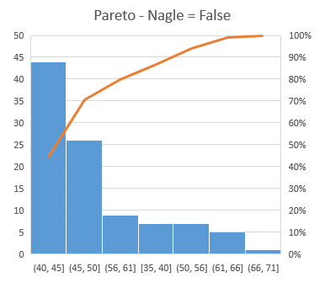
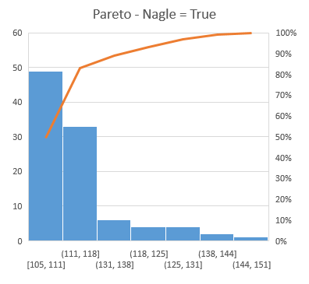
To Nagle or Not to Nagle?
Execution time reduce by 67% when [Nagle] = false.

Slide 15
Executing sample CRUD cmdlets
There following coding exercises will use the [ts4tests] Azure table store.
Select by column
Select by partition
Select by filter
Update one record
Delete one record
Interesting factoid, the x-box system uses table storage to save user achievements.
Example 4 – Sample CRUD code

Slide 16
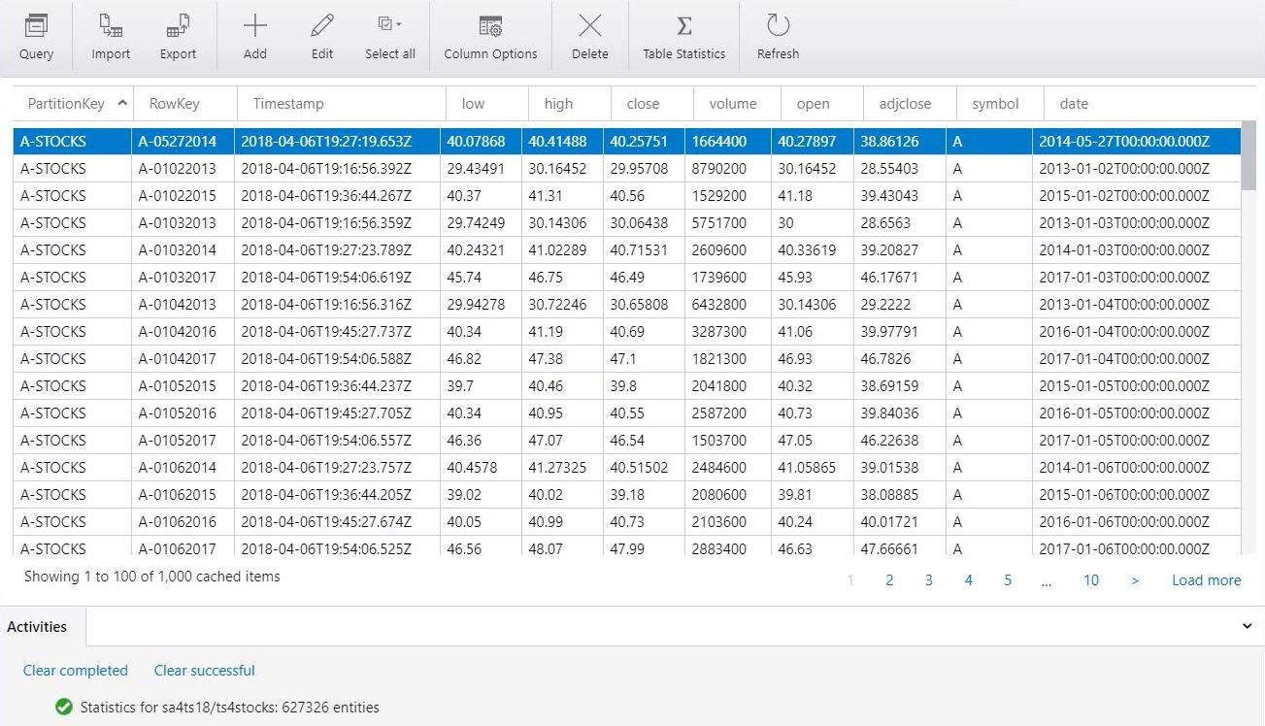
Azure Storage Explorer
This tool is a free download from Microsoft which be used to manage your table storage.
The ts4stocks store contains all S&P 500 stock data from 2013 to 2017.

Slide 17
Mixing Entities
There is a whole section of MSDN dedicated to talking about storage patterns. A given partition is not guaranteed to be on the same storage/compute in the data center. A row key has to be unique for a given table store.
Determining how to de-normalize data and partition for either fast inserts, updates or deletes is an art.
I am going to create two locations for Big Jon’s Investments. Each location is a partition key. On the other hand, we will be mixing properties within the partition.
Example 5 – Create mixed partitions

Slide 18
Key Value vs Database
PROS:
Relatively inexpensive
Can store TB of structured data
Data can be de-normalized
Ideal for web or mobile apps
CONS:
No support for constraints
Can not perform calculations
Can not aggregate data
Not ideal for data analysis

Slide 19
Summary
Some technical problems lend themselves to storing and retrieving data from a relational database management system (RDBMS).
Other technical problems do not lend themselves to storing and retrieving data from a predefined table.
Today we talk about the four typical “Not Only SQL” offerings: key-value store, document store, graph store and column store.
Consider using Azure Table Storage if your business problem fits the use case.

Slide 20
References
Table Storage Data Model
https://docs.microsoft.com/en-us/rest/api/storageservices/Understanding-the-Table-Service-Data-Model
Community PowerShell Module
https://blogs.technet.microsoft.com/paulomarques/2017/01/17/working-with-azure-storage-tables-from-powershell/
Azure Storage Explorer
https://azure.microsoft.com/en-us/features/storage-explorer/
Nagle Algorithm
https://blogs.msdn.microsoft.com/windowsazurestorage/2010/06/25/nagles-algorithm-is-not-friendly-towards-small-requests/
|

Slide 21
References (cont.)
X-Box & Table Storage
https://customers.microsoft.com/en-us/story/xbox-improves-services-and-delivery-speed-by-playing-g
Cosmos DB – Table storage offering
https://docs.microsoft.com/en-us/azure/cosmos-db/table-storage-how-to-use-powershell
Cosmos DB – Table storage design guide
https://docs.microsoft.com/en-us/azure/cosmos-db/table-storage-design-guide
|

Slide 22
Biography
John Miner is a Data Architect at Blue Metal helping corporations solve their business needs with various data platform solutions. He has over twenty five years of data processing experience, and his architecture expertise encompasses all phases of the software project life cycle, including design, development, implementation, and maintenance of systems. His credentials include undergraduate and graduate degrees in Computer Science from the University of Rhode Island. He has also earned certificates from Microsoft for Database Administration (MCDBA), System Administration (MCSA) and Data Management & Analytics (MCSE). Before joining Blue Metal, John won the Data Platform MVP award in 2014 and 2015 for his outstanding contributions to the SQL Server community. When he is not busy talking to local user groups or writing blog entries on new technology, he spends time with his wife and daughter enjoying outdoor activities. Some of John’s hobbies include wood working projects, crafting a good beer and playing a game of chess.
|

Slide 23
Thank You
We look forward to working with you to manage business today and transform the future

